Slide 1
Injecting and IoC containers

Slide 2
Module Overview
In this Module, we will learn the following:
Dependency Injection-Constructor Based and setter based.
Injecting Inner Beans.
Injecting Collection.
IoC Containers.

Slide 3
Dependency Injection
Dependency Injection
Java components or Java Classes in an application if independent then the possibility of reusability is increases and also, we can test them independently of other classes.
To decouple Java components from other Java components the dependency to a certain other class should get injected into them rather that the class itself creates or finds this object.
If there are two different classes and we need to use dependency injection from one class to other class, it can be done via following ways
construction injection
A setter setter injection
Notes:
<number>

Slide 4
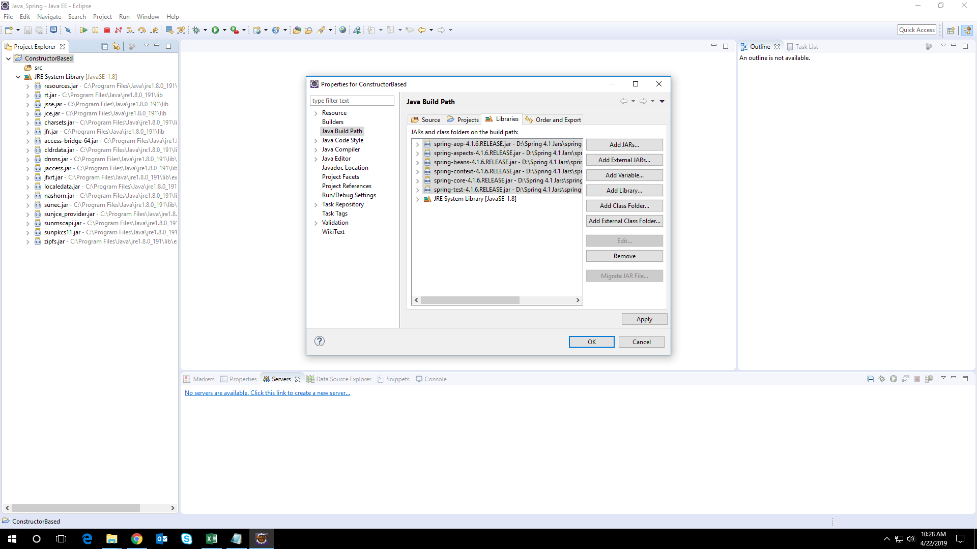
Demo: Constructor Based Dependency Injection
Duration: 10 min
Step 1: Create New Java Project and Name it.
Step 2: Add the following libraries to the class path of project

Slide 5
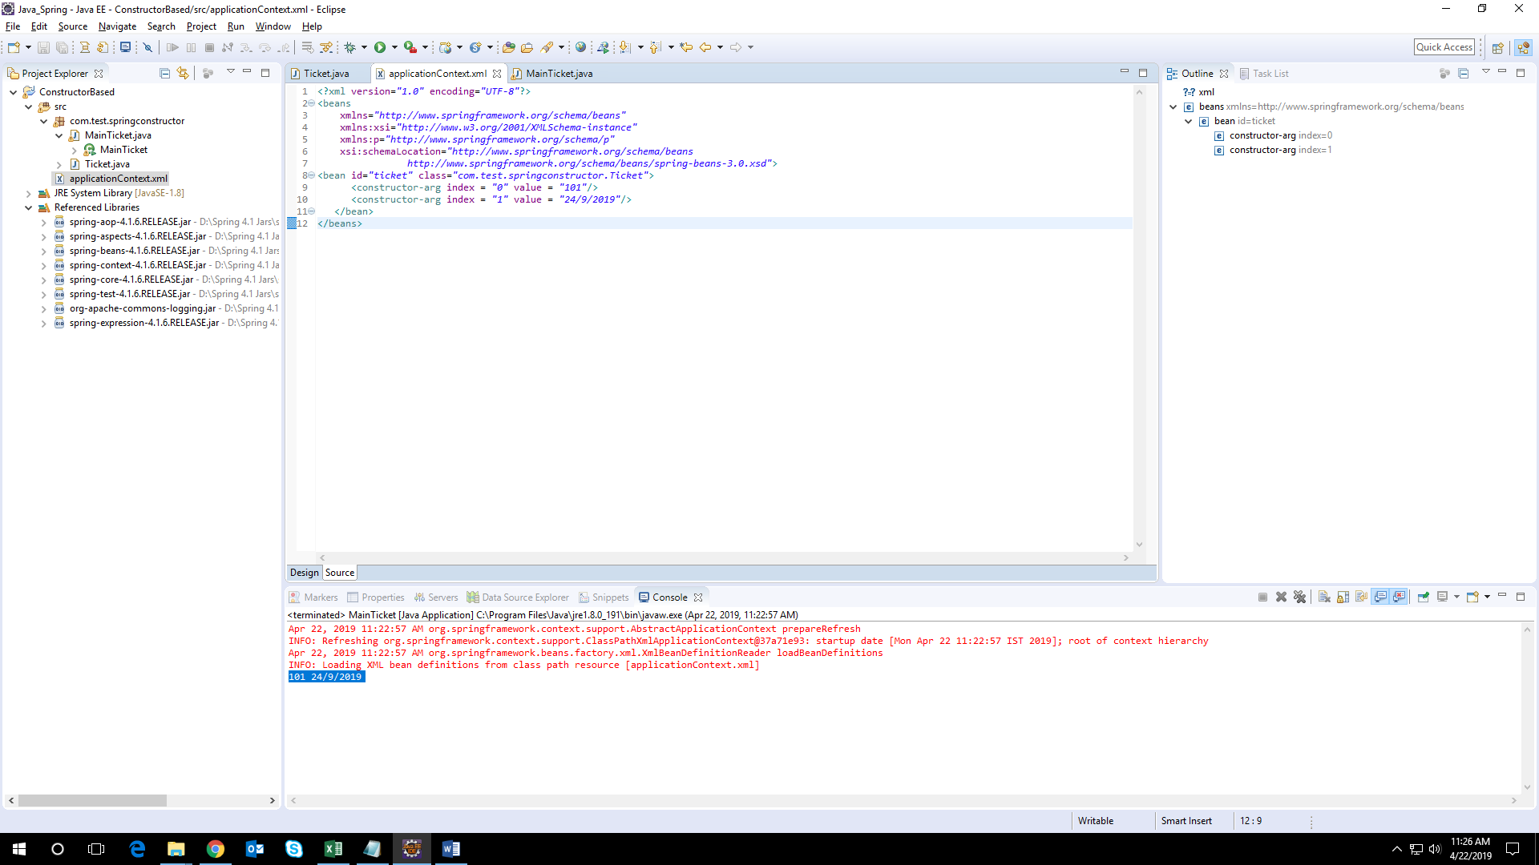
Demo: Constructor Based Dependency Injection Cont..
After Adding jars your project structure should look like below

Slide 6
Demo: Constructor Based Dependency Injection Cont..
Step 3: Create a new java class in package named com.test.springconstructor
Write the below code for java file
package com.test.springconstructor;
public class Ticket {
private int id;
private String ticketdate;
public Ticket() {System.out.println("Ticket is "+ ticketdate);}
public Ticket(int id) {this.id = id;}
public Ticket(String ticketdate) { this.ticketdate = ticketdate;}
public Ticket(int id, String ticketdate) {
this.id = id;
this.ticketdate = ticketdate;
}
void display(){
System.out.println(id+" "+ticketdate);
}
}

Slide 7
Demo: Constructor Based Dependency Injection Cont..
Step 4: Create applicationContext.xml file in src folder
applicationContext.xml
<?xml version="1.0" encoding="UTF-8"?>
<beans
xmlns="http://www.springframework.org/schema/beans"
xmlns:xsi="http://www.w3.org/2001/XMLSchema-instance"
xmlns:p="http://www.springframework.org/schema/p"
xsi:schemaLocation="http://www.springframework.org/schema/beans
http://www.springframework.org/schema/beans/spring-beans-3.0.xsd">
<bean id="ticket" class="com.test.springconstructor.Ticket">
<constructor-arg index = "0" value = "101"/>
<constructor-arg index = "1" value = "24/9/2019"/>
</bean>
</beans>
Notes:
In case if we pass different types to the constructor.
For e.g. for class −
package test;
public class test
{
public test(int year, String name)
{ // ... } }
The container can also use type matching with simple types, if you explicitly specify the type of the constructor argument using the type attribute. For e.g.
<beans>
<bean id = “testBean" class = “test.testBean">
<constructor-arg type = "int" value = “2017"/>
<constructor-arg type = "java.lang.String" value = “Nisha"/>
</bean>
</beans>
Finally, the best way to pass constructor arguments, use the index attribute to specify explicitly the index of constructor arguments. Here, the index is 0 based. For example −
<beans>
<bean id = “testBean" class = “test.testBean">
<constructor-arg index = "0" value = "2017"/>
<constructor-arg index = "1" value = “Nisha"/>
</bean>
</beans>
Note: In case you are passing a reference to an object, you need to use ref attribute of <constructor-arg> tag and if you are passing a value directly then you should use value attribute
<beans>
<bean id = “a1" class = “test.A1">
<constructor-arg ref = "b1"/>
<constructor-arg ref = “c1"/>
</bean>
<bean id = "b1" class = “test.B1"/>
<bean id = “c1" class = “test.C1"/>
</beans>
<number>

Slide 8
Demo: Constructor Based Dependency Injection Cont..
Step 5: Create MainApp.java to run the application
package com.test.springconstructor;
import org.springframework.beans.factory.BeanFactory;
import org.springframework.beans.factory.xml.XmlBeanFactory;
import org.springframework.context.ApplicationContext;
import org.springframework.context.support.ClassPathXmlApplicationContext;
import org.springframework.core.io.ClassPathResource;
import org.springframework.core.io.Resource;
public class MainTicket {
public static void main(String[] args) {
ApplicationContext context = new ClassPathXmlApplicationContext("applicationContext.xml");
Ticket t1=(Ticket)context.getBean("ticket");
t1.display();
}
}
Step 6: Run the project as Java Application.
We can see the following output
101 24/9/2019
Notes:
<number>

Slide 9
Demo: Constructor Based Dependency Injection Cont..
The container can also use type matching with simple types, if you explicitly specify the type of the constructor argument using the type attribute. For example −
<beans>
<bean id = "ticket" class = " com.test.springconstructor.Ticket ">
<constructor-arg type = "int" value = "101"/>
<constructor-arg type = "java.lang.String" value = "21/3/2019"/>
</bean>
</beans>
Finally, the best way to pass constructor arguments, use the index attribute to specify explicitly the index of constructor arguments. Here, the index is 0 based. For example −
<beans>
<bean id = "ticket" class = " com.test.springconstructor.Ticket ">
<constructor-arg index = "0" value = "101"/>
<constructor-arg index = "1" value = "21/3/2019"/>
</bean>
</beans>

Slide 10
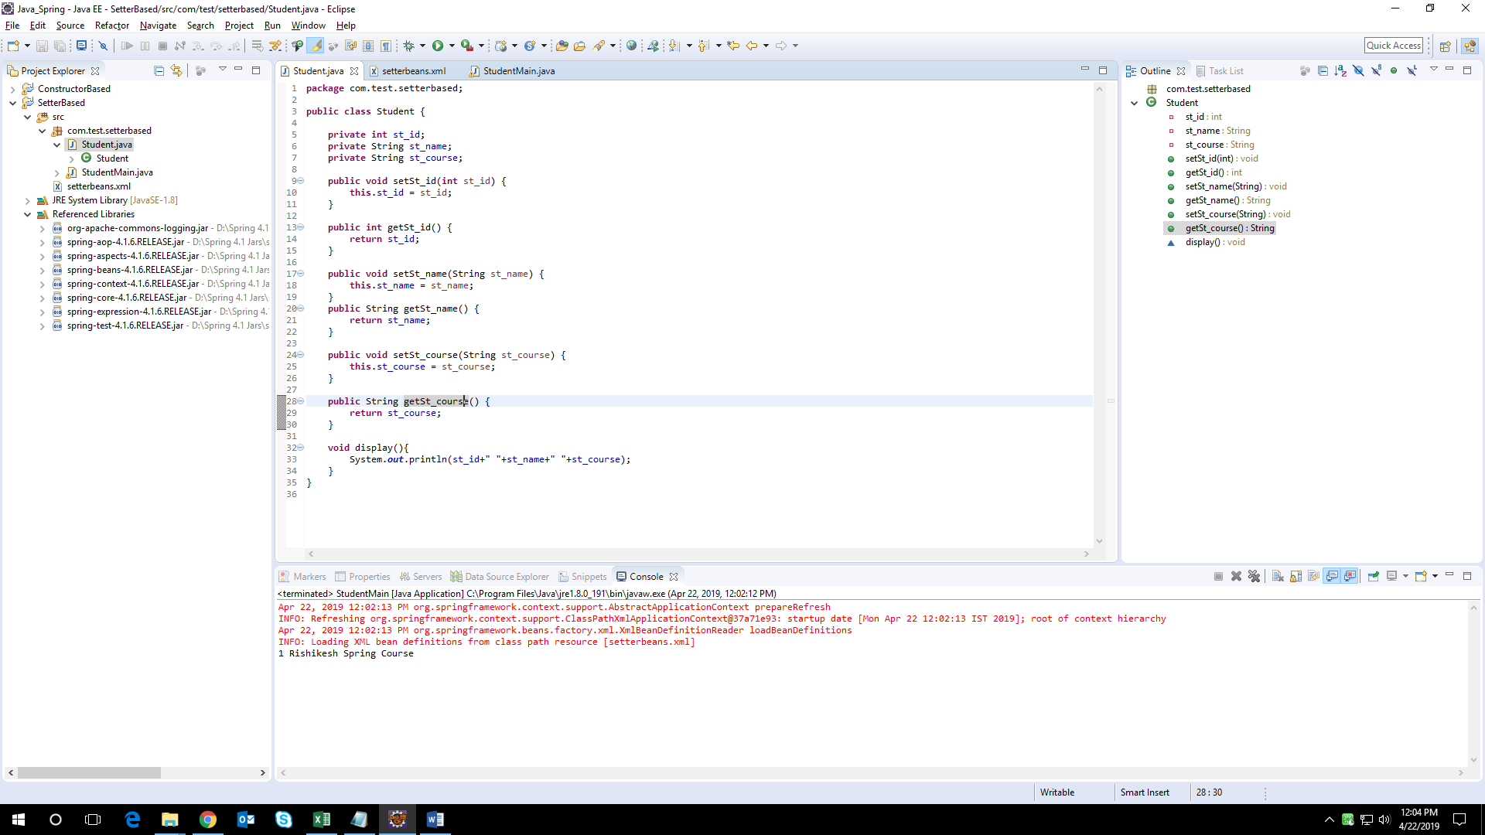
Demo: Setter Based Dependency Injection
Duration: 10 min
Step 1: Create New Java Project Name it.
Step 2 Add the below spring jars to project classpath.
Notes:
<number>

Slide 11
Demo: Setter Based Dependency Injection Cont..
Step 3: create Student.java file in package named com.test.setterbased and write below mentioned code
package com.test.setterbased;
public class Student {
private int st_id;
private String st_name;
private String st_course;
public void setSt_id(int st_id) {
this.st_id = st_id;
}
public int getSt_id() {
return st_id;
}
public void setSt_name(String st_name) {
this.st_name = st_name;
}
public String getSt_name() {
return st_name;}
Notes:
<number>

Slide 12
Demo: Setter Based Dependency Injection Cont..
public void setSt_course(String st_course) {
this.st_course = st_course;
}
public String getSt_course() {
return st_course;
}
void display(){
System.out.println(st_id+" "+st_name+" "+st_course); } }

Slide 13
Demo: Setter Based Dependency
Injection Cont..
Step 4: create setterbeans.xml in src folder
<?xml version="1.0" encoding="UTF-8"?>
<beans
xmlns="http://www.springframework.org/schema/beans"
xmlns:xsi="http://www.w3.org/2001/XMLSchema-instance"
xmlns:p="http://www.springframework.org/schema/p"
xsi:schemaLocation="http://www.springframework.org/schema/beans
http://www.springframework.org/schema/beans/spring-beans-3.0.xsd">
<bean id="student" class="com.test.setterbased.Student">
<property name="st_id">
<value>1</value>
</property>
<property name="st_name">
<value>Tom</value>
</property>
<property name="st_course">
<value>Spring Course</value>
</property>
</bean>
</beans>
Notes:
Let’s see the difference in setterbeans.xml file defined in the constructor-based injection and the setter-based injection.
The only difference is inside the <bean> element where we have used <constructor-arg> tags for constructor-based injection and <property> tags for setter-based injection.
The second important thing is that if you are passing a reference to an object, you need to use ref attribute of <property> tag and if you are passing a value directly then you should use value attribute.
<number>

Slide 14
Demo: Setter Based Dependency
Injection Cont..
package com.test.setterbased;
import org.springframework.context.ApplicationContext;
import org.springframework.context.support.ClassPathXmlApplicationContext;
public class StudentMain {
public static void main(String[] args) {
ApplicationContext context = new ClassPathXmlApplicationContext("setterbeans.xml");
Student st1=(Student)context.getBean("student");
st1.display();
}
}
Step 5: Run the mainjava file you can see the following output
1 Tom Spring Course

Slide 15
Injecting Inner Beans
Inner beans are the beans that are defined within the scope of another bean.
Thus, a <bean/> element inside the <property/> or <constructor-arg/> elements is called inner bean.
Here is an example how to inject inner beans within the scope of other beans
Follow the steps below:
Duration: 15 min
Step 1:
Create a project with a name InnerBeanInjectionExample and create a package com.test.innerbean under the src folder in the created project.
Step 2:
Add required Spring libraries using Add External JARs option as explained in the setterbased/constructor-based example.
Step3:
Create Java classes InvoiceGenerator, Product and MainInvoiceGenerator under the com.test.innerbean package.
Step 4:
Create Beans configuration file Innerbean.xml under the src folder.
Notes:
Inner classes are the classes which are defined inside the scope of another class. Similarly inner beans are the beans which are defined in the scope of another bean. Spring provides a way to inject inner beans also.
<number>

Slide 16
Injecting Inner Beans Cont..
MainInvoiceGenerator.java
package com.test.innerbean;
import org.springframework.context.ApplicationContext;
import org.springframework.context.support.ClassPathXmlApplicationContext;
public class MainInvoiceGenerator {
public static void main(String a[]){
ApplicationContext context = new ClassPathXmlApplicationContext("innerbean.xml");
InvoiceGenerator invoice = (InvoiceGenerator) context.getBean("invoicebean");
invoice.generateInvoice();
}
}
Notes:
Here is the xml based inner bean injection, note that when you are using inner bean configuration, bean id is not required.
The approach is same for setter based injection.
<number>

Slide 17
Injecting Inner Beans Cont..
innerbean.xml
<beans xmlns="http://www.springframework.org/schema/beans"
xmlns:xsi="http://www.w3.org/2001/XMLSchema-instance"
xsi:schemaLocation="http://www.springframework.org/schema/beans
http://www.springframework.org/schema/beans/spring-beans-3.0.xsd">
<bean id="invoicebean" class="com.test.innerbean.InvoiceGenerator">
<constructor-arg>
<bean class="com.test.innerbean.Product">
<property name="item" value="Book" />
<property name="price" value="450.60" />
<property name="address" value="Pune" />
</bean>
</constructor-arg>
</bean>
</beans>
Notes:
Here we are using constructor based injection, the approach is similar for setter based injection.
InvoiceGenerator class, which requires Product object is to be injected.
<number>

Slide 18
Injecting Inner Beans Cont..
InvoiceGenerator.java file
package com.test.innerbean;
public class InvoiceGenerator {
private Product prod_order;
public InvoiceGenerator(Product prod_order)
{
this.prod_order=prod_order;
}
public void setProdOrder(Product order){
this.prod_order=order;
}
public void generateInvoice(){
System.out.println("Getting Orders details...: "+prod_order.getItem());
}
}

Slide 19
Injecting Inner Beans Cont..
Product.java file
package com.test.innerbean;
public class Product {
private String item;
private String price;
private String address;
public String getItem() {
return item;
}
public void setItem(String item) {
this.item = item;
}
public String getPrice() {
return price;
}
public void setPrice(String price) {
this.price = price;
}
public String getAddress() {
return address;
}
public void setAddress(String address) {
this.address = address;
}
}

Slide 20
Injecting Inner Beans Cont..
After running the main java file you will get the following output:
Getting Orders details...: Book
Notes:
Inner beans are defined in a scope of another beans which means inner beans are not shared by another beans.
Inner beans are defined like below
<bean id=”outer_bean” class=”OuterBean”>
<property name=”innerbean”>
<bean class=”InnerBean”/>
</property>
</bean>
<number>

Slide 21
Injecting Collection
We can inject collection values by constructor in spring framework. We can use three elements inside the constructor-arg element.
It can be:
list
set
Map
Each collection can have string based and non-string-based values.

Slide 22
Demo: Injecting Collection
Below is the steps to inject collection in Spring Follow the steps below:
Duration: 10 min
Step 1:
Create a project with a name CollectionInjectionExample and create a package com.test.collection under the src folder in the created project.
Step 2:
Add required Spring libraries using Add External JARs option as explained in the setterbased/constructor-based example.
Step3:
Create Java classes ProductBean, ProductDetailsBean and CollectionMain under the com.test.collection package.
Step 4:
Create Beans configuration file collectionbean.xml under the sic folder.

Slide 23
Demo: Injecting Collection Cont..
CollectionMain.java file
package com.test.collection;
import org.springframework.context.ApplicationContext;
import org.springframework.context.support.ClassPathXmlApplicationContext;
public class CollectionMain {
public static void main(String[] args) {
// TODO Auto-generated method stub
ApplicationContext context = new ClassPathXmlApplicationContext("collectioninjection.xml");
ProductBean prod = (ProductBean) context.getBean("productbean");
System.out.println(prod);
}
}

Slide 24
Demo: Injecting Collection Cont..
package com.test.collection;
import java.util.List;
import java.util.Map;
import java.util.Properties;
import java.util.Set;
public class ProductBean {
private List<Object> lists;
private Set<Object> sets;
private Map<Object, Object> maps;
private Properties pros;
public List<Object> getLists() {
return lists;
}
public void setLists(List<Object> lists) {
this.lists = lists;
}
public Set<Object> getSets() {
return sets;
}
public void setSets(Set<Object> sets) {
this.sets = sets;
}
public Map<Object, Object> getMaps() {
return maps;
}
public void setMaps(Map<Object, Object> maps)
{
this.maps = maps;
}
public Properties getPros() {
return pros;
}
public void setPros(Properties pros) {
this.pros = pros;
}
@Override
public String toString() {
return "Product [lists=" + lists + ", sets=" + sets + ", maps=" + maps
+ ", pros=" + pros + "]";
} }

Slide 25
Demo: Injecting Collection Cont..
<beans xmlns="http://www.springframework.org/schema/beans"
xmlns:xsi="http://www.w3.org/2001/XMLSchema-instance"
xsi:schemaLocation="http://www.springframework.org/schema/beans
http://www.springframework.org/schema/beans/spring-beans-3.0.xsd">
<bean id="productbean" class="com.test.collection.ProductBean">
<property name="lists">
<list>
<value>1</value>
<ref bean="productdetailbean" />
<bean class="com.test.collection.ProductDetailsBean">
<property name="pr_name" value=“ProductList" />
<property name="pr_id" value="A11190" />
<property name="qty" value="28" />
<property name="price" value="280.70" />
</bean>
</list>
</property>

Slide 26
Demo: Injecting Collection Cont..
<property name="sets">
<set>
<set>
<value>1</value>
<ref bean="productdetailbean" />
<bean class="com.test.collection.ProductDetailsBean">
<property name="pr_name" value=“Peoductssets" />
<property name="pr_id" value="B2289" />
<property name="qty" value="28" />
<property name="price" value="280.70" />
</bean>
</set>
</set>
</property>
<property name="maps">
<map>
<entry key="Key 1" value="1" />
<entry key="Key 2" value-ref="productdetailbean" />
<entry key="Key 3">

Slide 27
Demo: Injecting Collection Cont..
<bean class="com.test.collection.ProductDetailsBean">
<property name="pr_name" value=“ProductMap" />
<property name="pr_id" value="M555" />
<property name="qty" value="28" />
<property name="price" value="330.56"/>
</bean>
</entry>
</map>
</property>
<property name="pros">
<props>
<prop key=“tech">technical@domain.com</prop>
<prop key=“logistic">logistic@domain.com</prop>
</props>
</property>
</bean>
<bean id="productdetailbean" class="com.test.collection.ProductDetailsBean">
<property name="pr_name" value="Mobile Phone" />
<property name="pr_id" value="A223" />
<property name="qty" value="5" />
<property name="price" value="45390.50"/>
</bean>
</beans>

Slide 28
Dependency Injection
Advantages of Dependency Injection
DI advantages of high cohesion are:
Reduced module complexity
Increased system maintainability, because logic changes in the domain affect fewer modules.
Increased module reusability.
DI does not require any changes in code behaviour it can be applied to legacy code as refactoring.
DI allows a client to remove all knowledge of a concrete implementation that needs to use. It is more reusable, more testable, more readable code.
DI makes it possible to eliminate, or at least reduce unnecessary dependencies.
DI allows concurrent or independent development.
DI decreases coupling between a class and its dependency.
Notes:
Advantages of Dependency Injection(DI)
DI allows a client the flexibility of being configurable. Only client's behavior is fixed.
Testing can be performed using mock objects.
Loosely couple architecture.
<number>

Slide 29
Dependency Injection
Disadvantages of Dependency Injection
DI creates clients that demand configure details supplied by construction code.
DI can make code difficult to trace because it separates behavior from construction; this means developers refer to more files to follow how a system performs.
DI can cause an explosion of types, especially in languages that have explicit interface types like C# and Java.
DI can encourage dependence on DI framework.
Tight coupling :
A change in only one module usually forces a ripple effect of changes in other modules.
Notes:
<number>

Slide 30
IoC Containers
The IoC container of Spring is at the heart of the Spring Framework.
The container will create the objects, wire them together, configure them, and manage their complete life cycle from creation till destruction.
It uses dependency injection (DI) to manage the application components.
Spring provides following two distinct types of containers.
BeanFactory container
ApplicationContext container

Slide 31
IoC Container Cont..
1. Spring BeanFactory container
It has more capability than being the interface for an advanced factory capable of maintaining a registry of different beans and their dependencies.
We can read bean definitions and access them using the bean factory. Using BeanFactory we create one and read in bean definitions in the XML format as follows:
How to Create XmlBeanFactory
InputStream inpstr = new FileInputStream("beans.xml");
BeanFactory factory = new XmlBeanFactory(inpstr);
//Get bean
HelloWorld obj = (HelloWorld) factory.getBean(“This is Spring Core");

Slide 32
IoC Container Cont..
Other ways to create bean factory are as below:
Resource rs= new FileSystemResource("beans.xml");
BeanFactory factory = new XmlBeanFactory(rs);
ClassPathResource rs = new ClassPathResource("beans.xml");
BeanFactory factory = new XmlBeanFactory(rs);

Slide 33
IoC Container Cont..
2. Spring ApplicationContext container
It includes all functionality of the BeanFactory container hence widely recommended over the BeanFactory.
BeanFactory can still be used for lightweight applications like mobile devices or applet based applications where data volume and speed is significant.
How to create ApplicationContext
ApplicationContext context = new FileSystemXmlApplicationContext("beans.xml");
HelloWorld obj = (HelloWorld) context.getBean("helloWorld");
Notes:
The most commonly used ApplicationContext implementations are:
FileSystemXmlApplicationContext – This container loads the beans definition from an XML file. Specify the complete path of the XML bean configuration file to the constructor.
ClassPathXmlApplicationContext – This container loads the beans definitions from an XML file. No need of the full path of the XML file but you need to set CLASSPATH properly because this container will look bean configuration XML file in CLASSPATH.
WebXmlApplicationContext – This container loads the XML file with beans definitions from within a web application.
<number>

Slide 34
Summary
In this Module, we have learnt the following:
What is Dependency Injection
Implementing Constructor Based and setter-based Dependency Injection.
Injecting Inner Beans and its implementation.
Injecting Collection and its implementation.
Advantages & Disadvantages of Dependency Injection.
Injecting Collection.
What are IoC Containers.
BeanFactory container
ApplicationContext container

Slide 35

Thank You
<number>
Notes:
<number>

